Slide 1

Enhanced Traffic Sign Recognition With CNN Using Image Processing
Team Members:
Sai Keerthi Nelluri (snelluri@uwm.edu)
Shivam Jayeshkumar Mehta (sjmehta@uwm.edu)
Rajesh Mahendran (mahendr2@uwm.edu)

Slide 2
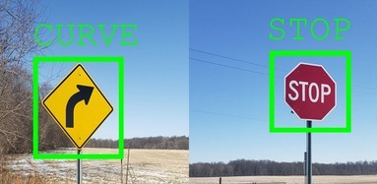
Introduction
Our project aims to develop a Convolutional Neural Network(CNN) model for the recognition and classification of traffic signs and then further enhance its accuracy by using Image processing techniques to preprocess the images to .

Slide 3
Motivation
Traffic signs manage traffic flow, maintain road safety, and give drivers vital information. Thus, traffic sign identification systems are becoming more and more essential as the world moves toward more intelligent and automated transportation systems.
Moreover By leveraging CNNs for traffic sign recognition, we can create more intelligent transportation systems that enhance safety, ensure compliance, and adapt seamlessly to the evolving technological landscape.
Additionally by using image processing techniques we can further enhance the accuracy and reliability of the model.

Slide 4
How does it Work?
We are using a subset of German Traffic Sign Recognition Benchmark (GTSRB) dataset to develop and test our model
We are also using tools and technologies like:
Python
TensorFlow
OpenCV
Scikit-Learn

Slide 5
STEP 1: Image Preprocessing
Conversion to Grayscale:
Reduces image complexity by converting from three color channels to one.
Enhances computational efficiency focuses learning on the structure and shapes in the images rather than color, which is not critical for traffic sign recognition.
CLAHE (Contrast Limited Adaptive Histogram Equalization):
Improves image contrast by applying localized histogram equalization.
Enhances visibility of important features without amplifying noise.
In simpler words it makes features more distinguishable, which is particularly useful for images with poor lighting conditions.

Slide 6
STEP 2: Image Filtering
Filtering:This step is performed to further enhance or suppresse specific image features to improve recognition accuracy. It Includes:
Gaussian filter : used to reduce noise and details
Sobel filters: used for edge detection
Sharpening filter: used to enhance edges
Normalization: Scales pixel values to a range of 0 to 1, facilitating faster convergence during training by ensuring consistent scale across all input features.

Slide 7
STEP 3:Model Training
Image Augmentation: Includes random rotations and scaling to introduce variability into the dataset, simulating different angles and distances from which signs might be viewed mimicking real-life conditions. Which increases the robustness of the model.
CNN Model: this is where we design a neural network architecture that can effectively learn to classify traffic signs from images. It includes:
Convolutional Layers: which applies multiple convolutional layers with filters to extract features from the input images
Pooling Layers: they reduce spatial dimensions of images and reduce computational complexity and normalizing inputs for efficient learning.
Dropout: Integrating dropouts of data to prevent overfitting in the model.
Output Layer: uses flatten and dense layers for multi-class classification of traffic signs.

Slide 8
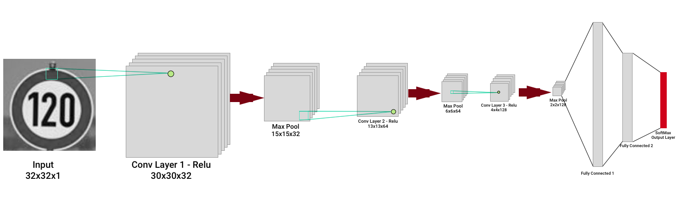
CNN - Model Diagram

Slide 9
CODE OVERVIEW
Regular version
Load
Image Dataset
Image preprocessing
Grayscale conversion
Model
Training
Enhanced version:
Load
Image Dataset
Image preprocessing
Grayscale conversion
+
CLAHE
Image Filtering
Gaussian filter +
Sobel filter +
Sharpening filter
Model
Training

Slide 10
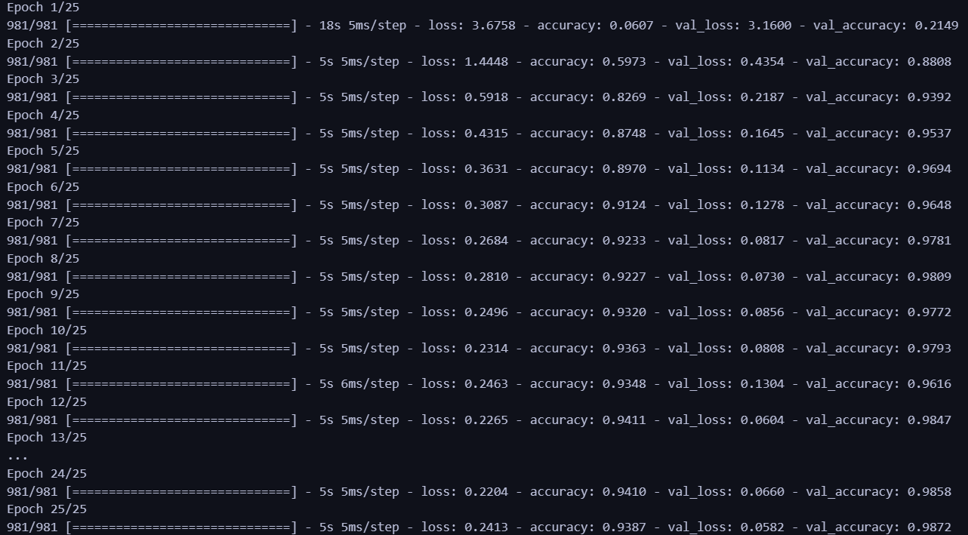
Results
Without using filters: At Epoch 25 , accuracy is 93%

Slide 11
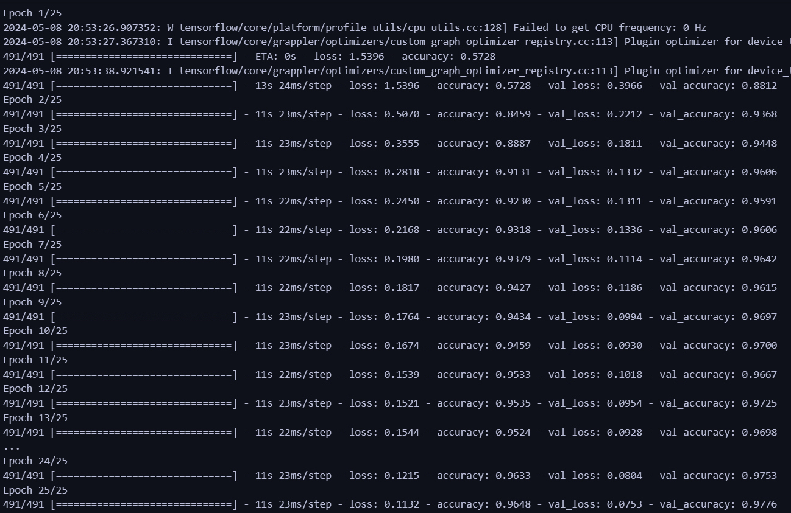
Results
Using filters: At Epoch 25 , accuracy is 96%

Slide 12
Applications
Autonomous Vehicles: One of the most direct applications is in the development of autonomous where effective traffic sign recognition is crucial for these vehicles to navigate roads safely and adhere to local traffic laws.
Driver Assistance Systems: For vehicles that are not fully autonomous, traffic sign recognition can enhance driver assistance systems such as adaptive cruise control, lane keeping assistance, and speed alert systems.
Traffic Law Enforcement and Compliance: Traffic sign recognition can be used in mobile or stationary systems to monitor compliance with traffic signs, assisting law enforcement in identifying violations like ignoring stop signs or speeding.

Slide 13
Applications
Educational Tools and Simulations: In driver education, traffic sign recognition systems can be used within driving simulators to train and test new drivers on their ability to observe and respond to traffic signs under various conditions. Moreover, advanced driving simulators can use traffic sign recognition to evaluate a driver's response to various road signs under simulated conditions.
Vision Disability Aid: people suffering from partial vision impairments can be assisted and guided through traffic signs recognition systems to aid them in basic on foot commutes.

Slide 14
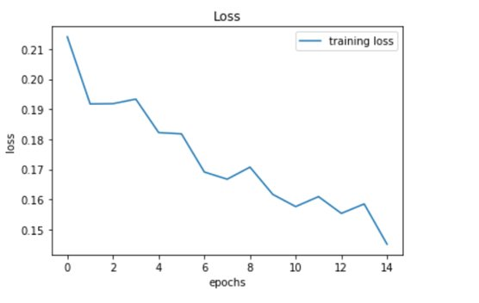
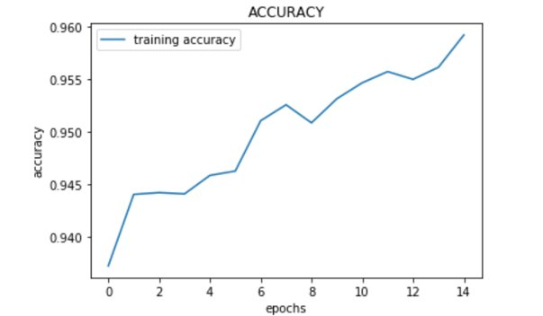
Conclusion
The goal of this project is to develop an efficient traffic sign recognition system over GTSRB dataset.The traffic sign recognition model is very helpful for driver safety with increasing traffic. It is done using CNN and image processing, After 25 epochs it has achieved an accuracy of 96.4%, with each epoch making the the model more accurate . But, there may be few challenges with regards to the vast variety for weather conditions and obstructions we might not have accounted for and a the model being trained using a much smaller and limited dataset.

Slide 15
CONTRIBUTIONS
Sai Keerthi Nelluri : Image Filtering
Shivam Mehta: Model Training
Rajesh Mahendran: Image Preprocessing

Slide 16
THANK YOU

